Slide 1
Introduction To Python
Python is a very versatile language. It has thousands of libraries and modules to work with.
Personally, I think Python is really fun to work with when compared to all the other languages out there. It is very beginner friendly which is very important and the syntax is very simple to figure out. As a beginner, think this is very vital when starting out with a language.
Best of all, no semicolon, right?
Well since Python and most of its libraries are open source it has gained a lot of traction among startups and the industry as well. And this definitely leads to millions of happy learners across the globe.

Slide 2
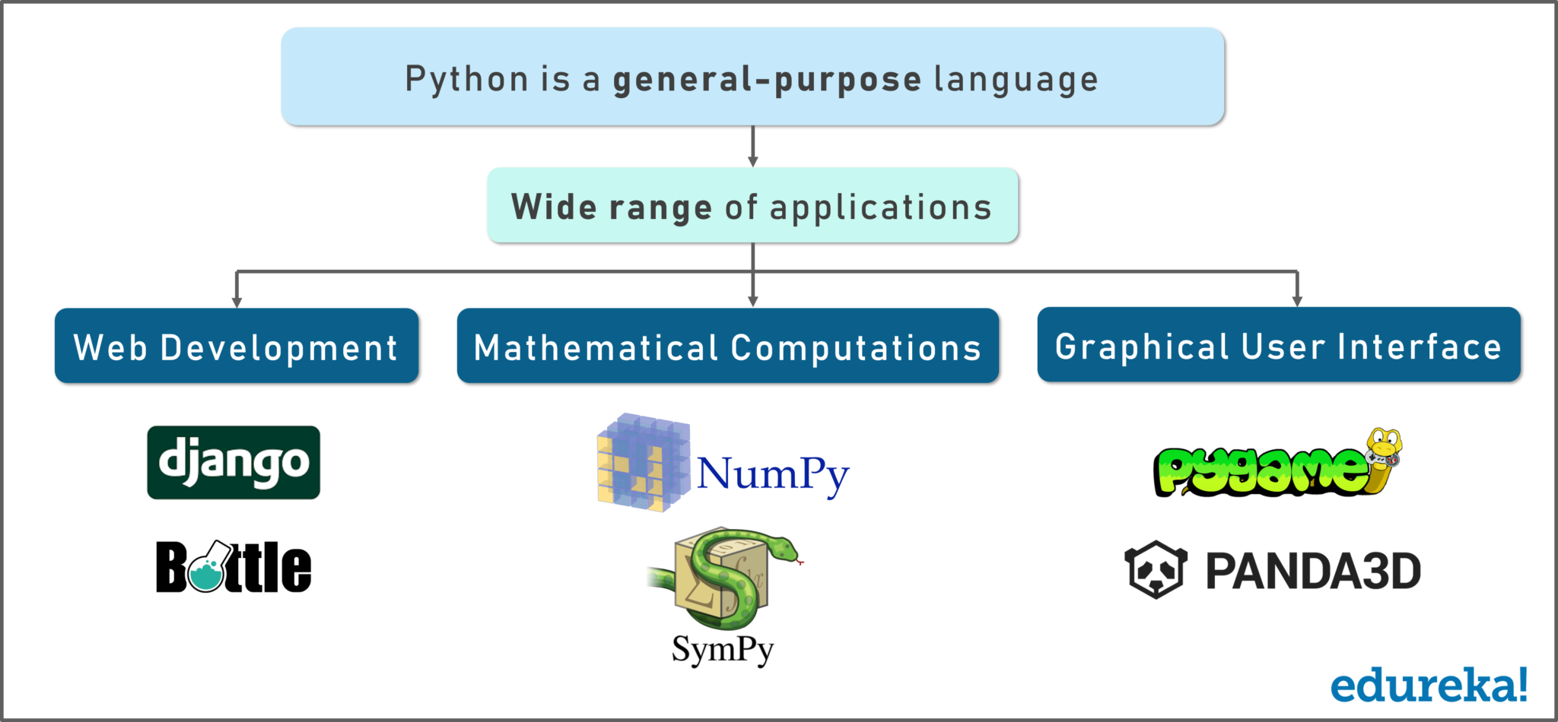
Everything from web development using Django and bottle. Mathematical computations using Numpy, designing your own GUI using Tkinter and making your own games using Pygame and so on.

Slide 3
Why Should You Learn Python?
Python is a general-purpose language. It has a wide range of applications from Web development (like Django and Bottle), scientific and mathematical computing (Orange, SymPy, NumPy) to desktop graphical user Interfaces (Pygame, Panda3D).
The syntax of the language is clean and the length of the code is relatively short. It’s fun to work in Python because it allows you to think about the problem rather than focusing on the syntax.

Slide 4
Every Fortune 500 company that exists today uses Python in one way or the other. You don’t even have to do any digging to know this fact. Again, as I said Python is extremely popular among both startups and established industry giants.
Programming in Python is fun. It’s easier to understand and write Python code. Why? The syntax feels natural.

Slide 5
Installing Python On Windows
Installing Python on Windows is a slightly longer process when compared to installing Python on Linux. In Linux, it is as easy as running a command and having it set up. With Windows, it takes a slightly different route.

Slide 6
To get started working with Python 3, you’ll need to have access to the Python interpreter. There are several common ways to accomplish this:
Python can be obtained from the Python Software Foundation website at python.org. Typically, that involves downloading the appropriate installer for your operating system and running it on your machine.
Some operating systems, notably Linux, provide a package manager that can be run to install Python.
On macOS, the best way to install Python 3 involves installing a package manager called Homebrew. You’ll see how to do this in the relevant section in the tutorial.
On mobile operating systems like Android and iOS, you can install apps that provide a Python programming environment. This can be a great way to practice your coding skills on the go.

Slide 7
Alternatively, there are several websites that allow you to access a Python interpreter online without installing anything on your computer at all.
Note: There is a chance that Python may have been shipped with your operating system and is already installed. Even if that is the case, it may be that the installed version is outdated, in which case you will want to obtain the latest version anyhow.
It is highly unlikely that your Windows system shipped with Python already installed. Windows systems typically do not. Fortunately, installing does not involve much more than downloading the Python installer from the python.org website and running it. Let’s take a look at how to install Python 3 on Windows:

Slide 8
Step 1: Download the Python 3 Installer
Open a browser window and navigate to the Download page for Windows at python.org.
Underneath the heading at the top that says Python Releases for Windows, click on the link for the Latest Python 3 Release – Python 3.x.x. (As of this writing, the latest version is Python 3.7.2.)
Scroll to the bottom and select either Windows x86-64 executable installer for 64-bit or Windows x86 executable installer for 32-bit.
But do we pick 32-bit or the 64-bit installer?
For Windows, you can choose either the 32-bit or 64-bit installer. Here’s what the difference between the two comes down to:

Slide 9
If your system has a 32-bit processor, then you should choose the 32-bit installer.
On a 64-bit system, either installer will actually work for most purposes. The 32-bit version will generally use less memory, but the 64-bit version performs better for applications with intensive computation.
If you’re unsure which version to pick, go with the 64-bit version.

Slide 10
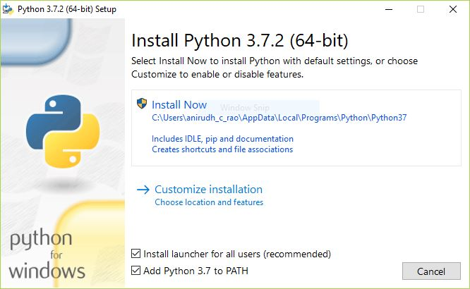
Step 2: Run the Installer
Once you have chosen and downloaded an installer, simply run it by double-clicking on the downloaded file. A dialog should appear that looks something like this:

Slide 11
Important: You want to be sure to check the box that says Add Python 3.x to PATH as shown to ensure that the interpreter will be placed in your execution path.
Then just click Install Now. That should be all there is to it. A few minutes later you should have a working Python 3 installation on your system.

Slide 12
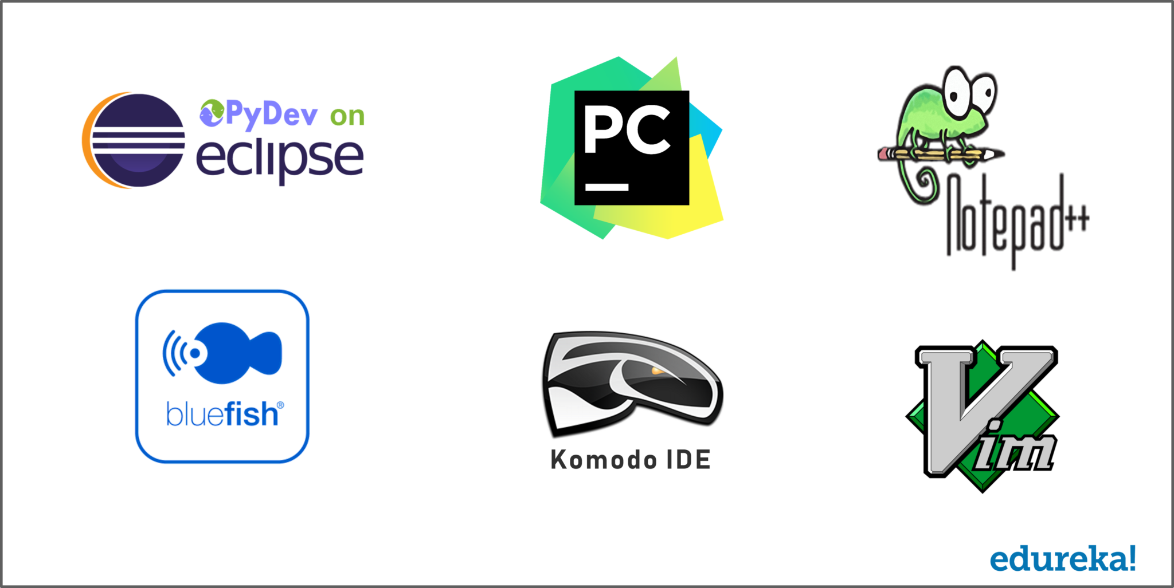
Python Development Environments
There are many good IDEs to code with Python and to use on a daily basis.
We have Pydev for eclipse, Pycharm, notepad++ and bluefish for you mac users. We have Komodo and Vim as well.
Check out the following image:

Slide 13
Introduction To Python
Python in simple words is a High-Level Dynamic Programming Language which is interpreted. Guido Van Rossum, the father of Python had simple goals in mind when he was developing it, easy looking code, readable and open source. Python is ranked as the 3rd most prominent language followed by JavaScript and Java in a survey held in 2018 by Stack Overflow which serves proof to it being the most growing language.
What is Python?
Python is currently my favorite and most preferred language to work on because of its simplicity, powerful libraries, and readability. You may be an old school coder or may be completely new to programming, Pyth
on is the best way to get started!

Slide 14
python provides features listed below :
Simplicity: Think less of the syntax of the language and more of the code.
Open Source: A powerful language and it is free for everyone to use and alter as needed.
Portability: Python code can be shared and it would work the same way it was intended to. Seamless and hassle-free.
Being Embeddable & Extensible: Python can have snippets of other languages inside it to perform certain functions.
Being Interpreted: The worries of large memory tasks and other heavy CPU tasks are taken care of by Python itself leaving you to worry only about coding.
Huge amount of libraries: Data Science? Python has you covered. Web Development? Python still has you covered. Always.
Object Orientation: Objects help breaking-down complex real-life problems into such that they can be coded and solved to obtain solutions.

Slide 15
Python Interpreter
An interpreter is a computer program that directly executes, i.e. performs, instructions written in a programming or scripting language, without requiring them previously to have been compiled into a machine language program. So unlike Java, Python uses an interpreter.
The interpreter is a program that we need to run our python code or scripts. It basically provides an interface between the code and the computer hardware to get the results of the code.
No matter in which programming language the code is written, it goes through an interpreter when it comes to python. For example pypy is used to execute the code written in python.

Slide 16
Python IDE
IDE typically provides code editor, compiler/ interpreter and debugger in one GUI (Graphical User Interface). It encapsulates the entire process of code creation, compilation and testing which increases the productivity of developers.
A developer working with an IDE starts with a model, which the IDE translates into suitable code. The IDE then debugs and tests the model-driven code, with a high level of automation. Once the build is successful and properly tested, it can be deployed for further testing through the IDE or other tools outside of the IDE.

Slide 17
Which Python IDE?
Always keep the following points in mind while choosing the best IDE for Python:
Level of expertise (beginner, professional) of the programmer
The type of industry or sector where Python is being used
Ability to buy commercial versions or stick to the free ones
Kind of software being developed
Need to integrate with other languages
Once these points are decided upon, the programmer can easily select among the IDEs based on the given features.

Slide 18
Why Learn Python?
Python’s syntax is very easy to understand. The lines of code required for a task is less compared to other languages. Let me give you an example – If I have to print “Welcome To Class!” all I have to type:
print(“Welcome To Class”)
Let’s look at some cool features of Python:
Simple and easy to learn
Free and Open Source
Portable
Supports different programming paradigm
Extensible

Slide 19
Python Applications
Artificial Intelligence
Desktop Application
Automation
Web Development
Data Wrangling, Exploration And Visualization

Slide 20
Python Basics
The basic concepts in any programming language are the foundation of any programmer, We will start with the most basic concept in python.
Python Keywords
Keywords are nothing but special names that are already present in python. We can use these keywords for specific functionality while writing a python program.

Slide 21
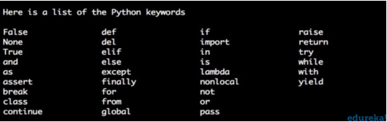
Following is the list of all the keywords that we have in python:

Slide 22
Python Comments
programmer-coherent statements, that describe what a block of code means. They get very useful when you are writing large codes. It’s practically inhuman to remember the names of every variable when you have a hundred-page program or so. Therefore, making use of comments will make it very easy for you, or someone else to read as well as modify the code.
#this is a single line comment
#this is a multi
#line comment
"""this is a docstring
comment
i hope it is clear
"""

Slide 23
Python Block Comments
A block comment in python is written with the same indentation as the code, it is used to explain the code. A block comment looks something like the one written in the example below.
# this is a print statement
print(“hello world”)

Slide 24
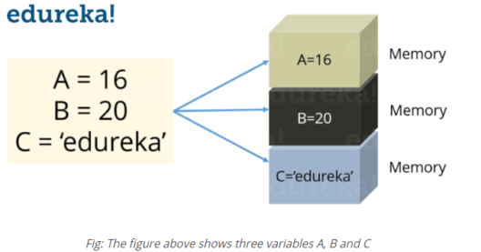
Python Variables
Variables are nothing but reserved memory locations to store values. This means that when you create a variable you reserve some space in memory.
In Python you don’t need to declare variables before using it, unlike other languages like Java, C etc.

Slide 25
Assigning values to a variable
Python variables do not need explicit declaration to reserve memory space. The declaration happens automatically when you assign a value to a variable. The equal sign (=) is used to assign values to variables. Consider the below example:
S = 10
print(S)
This will assign value ‘10’ to the variable ‘S’ and will print it. Try it yourself.

Slide 26
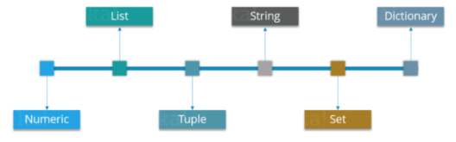
Data Types In Python
Python supports various data types, these data types defines the operations possible on the variables and the storage method. Below is the list of standard data types available in Python:

Slide 27
Python Strings
Strings are among the most popular data types in Python. We can create them simply by enclosing characters in quotes. Python treats single and double quotes in exactly the same fashion. Consider the example below:
S= "Welcome To Python!"
D = ‘Class!'

Slide 28
Python String Methods
Some of the string methods used in python are written below:
strip()
Count()
split()
translate()
index()
format()
find()
center()
join()

Slide 29
Python String Operations
Syntax | Operation
print (len(String_Name)) | String Length
print (String_Name.index(“Char”)) | Locate a character in String
print (String_Name.count(“Char”)) | Count the number of times a character is repeated in a String
print (String_Name[Start:Stop]) | Slicing
print (String_Name[::-1]) | Reverse a String
print (String_Name.upper()) | Convert the letters in a String to upper-case
print (String_Name.lower()) | Convert the letters in a String to lower-case

Slide 30
Python Numbers
Just as expected Numeric data types store numeric values. They are immutable data types, this means that you cannot change its value. Python supports three different Numeric data types:
Python Integer
It holds all the integer values i.e. all the positive and negative whole numbers, example – 10.
Python Float
It holds the real numbers and are represented by decimal and sometimes even scientific notations with E or e indicating the power of 10 (2.5e2 = 2.5 x 102 = 250), example – 10.24.

Slide 31
Python Complex
These are of the form a + bj, where a and b are floats and J represents the square root of -1 (which is an imaginary number), example – 10+6j.
Python Boolean
These are the decisive data types, they only return categorical value, i.e true or false.
Now you can even perform type conversion. For example, you can convert the integer value to a float value and vice-versa. Consider the example below:

Slide 32
A = 10
# Convert it into float type
B = float(A)
print(B)
The code above will convert an integer value to a float type. Similarly you can convert a float value to integer type:
A = 10.76
# Convert it into float type
B = int(A)
print(B)

Slide 33
Thanks

